Slide 1
Discounted Cash Flow Models

Slide 2
What is a Discounted Cash Flow Model?
A Discounted Cash Flow Model is a theoretical way of valuing a company buy projecting out its’ future cash flows and discounting them to find the Present Value of a firm
Free Cash Flow
Discounted Cash Flow Model
Calculating Discount Rate
Calculating Terminal Value

Slide 3
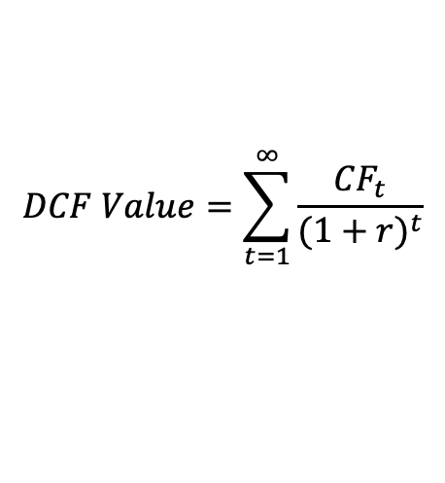
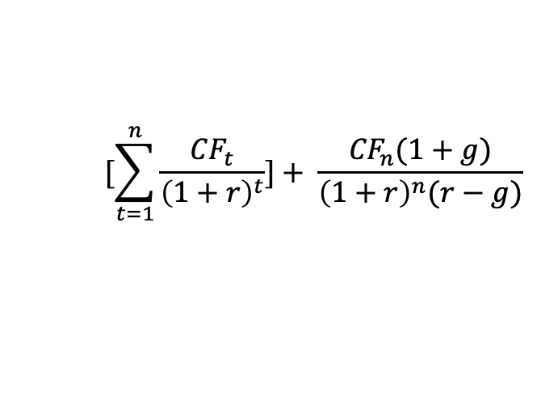
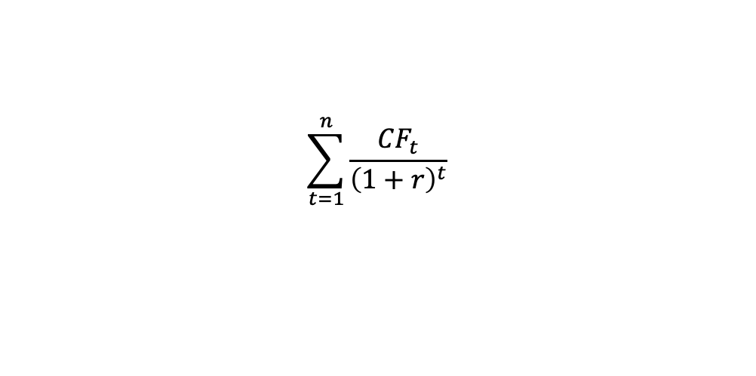

Mathematical Overview of a DCF
Discounted Cash Flow Model
Expands to
Expands to
Free Cash Flow
Expands to
Calculating Terminal Value
Expands to
CF_{t} = Cash Flow in Year ”t” g = Terminal Growth Rate
r = Discount Rate n = Last year of projections

Slide 4
Free Cash Flow

Slide 5
Unlevered Free Cash Flow vs. Free Cash Flow to Equity
Free Cash Flow is a key metric used by investors to examine how much cash a firm can produce after spending everything it has to run the business
Unlevered Free Cash Flow
Levered Free Cash Flow
Metric that finds available cash to the entire firm (debtholders and equity holders)
Used for calculating enterprise value, or the value to the entire firm
Metric that finds available cash to only the equity holders of a business
This is the cash flow available to equity holders after interest and debt have been paid
Used for calculating equity value
Not typically used

Slide 6
Thinking through Unlevered Free Cash Flow
Step 1: Begin with Earnings Before Interest and Taxes (EBIT)
Step 2: Subtract Taxes
Gov’t always takes a portion of EBIT that neither the firm or stakeholders can access
Step 3: Add back D&A and other non-cash expenses
want to figure out true change in cash
Step 4: Subtract Capital Expenditures.
CapEx is is a real cash use but not included in EBIT.
Step 5: Subtract Increases in Net Working Capital
Changes in working capital represent an inflow or outflow of cash to change these assets.

Slide 7
ULFCF Steps 1 & 2 – EBIT and NOPAT
EBIT stands for “Earnings Before Income and Taxes”
Net Operating Profit After Taxes represents your post tax operating income
Focuses on income that has come directly from operations.

Slide 8
Different Ways of Calculating EBIT
EBIT = Net Income + Interest + Taxes
EBIT = Revenue – COGS – Operating Expenses
EBIT = EBIT Margin * Revenue
Often used for DCF projections

Slide 9
Operating Income vs EBIT
Operating Income reported on Balance Sheet
only includes operating-related revenues and expenses
EBIT includes interest and tax hold on the business
For our purposes they are practically the same
EBIT is technically not GAAP so companies can add in other revenues and
interests

Slide 10
UFCF Steps 3-4: D&A and Capital Expenditures
Found on the Cash Flow Statement
D&A –> Cash Flow From Operations
Capital Expenditures -> Cash Flow From Investing
Capital Expenditures are a real use of cash
D&A are non-cash expenses that are included in EBIT Value
(must add back)

Slide 11
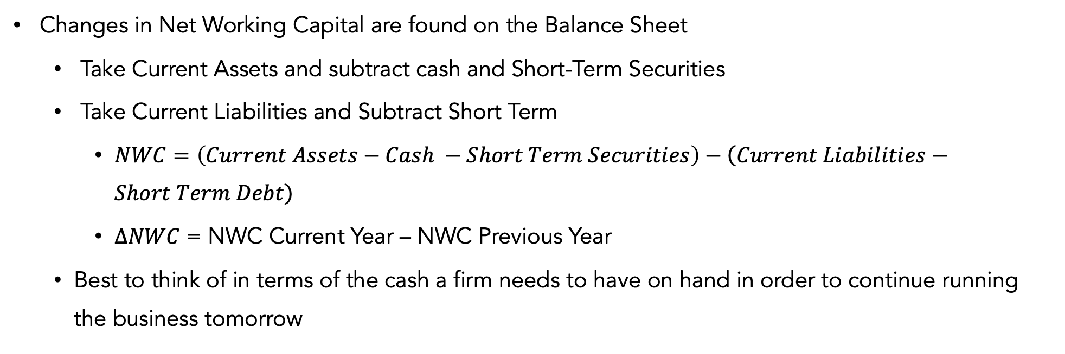
Change in Net Working Capital

Slide 12
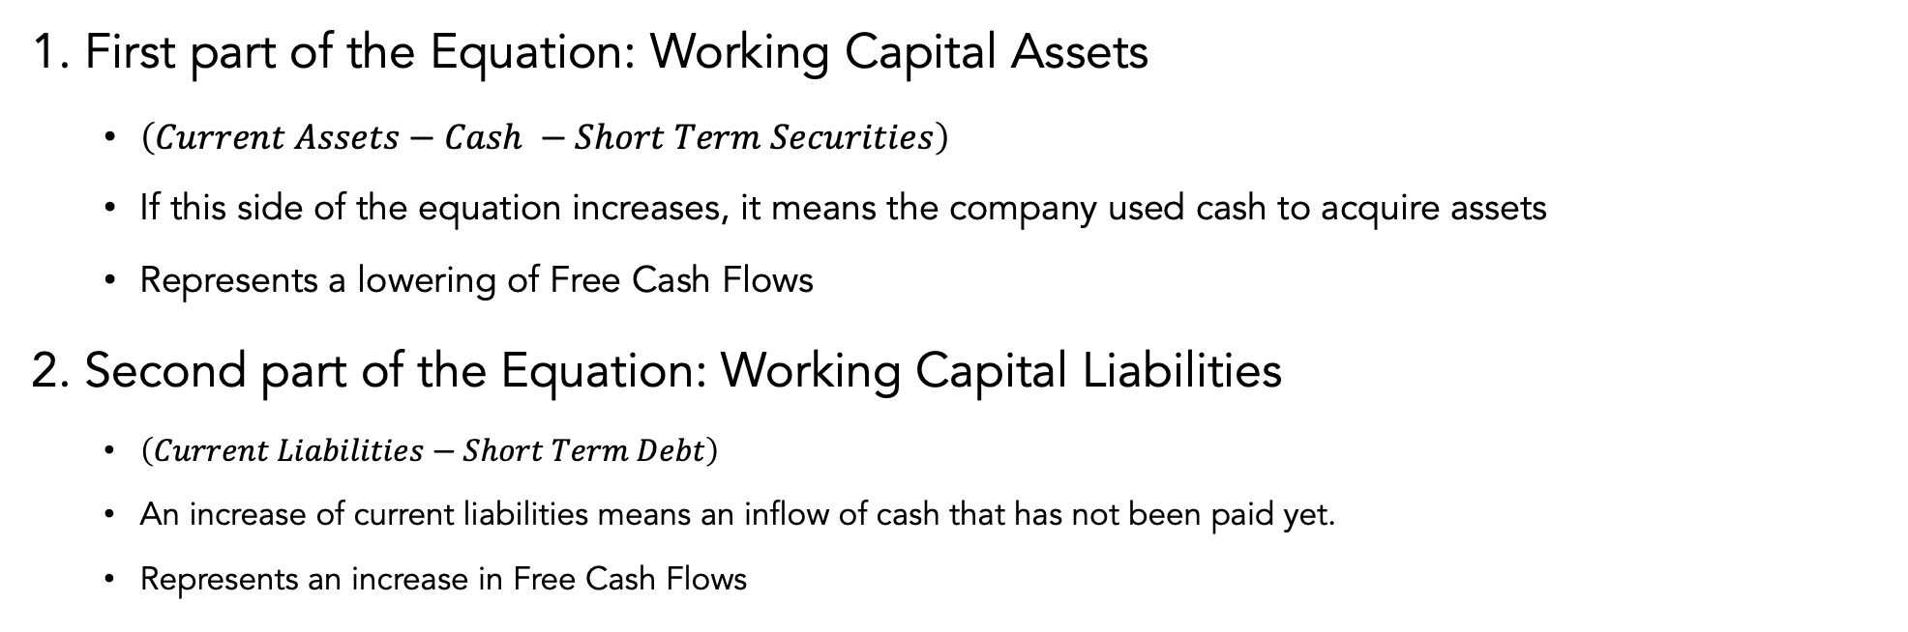
More on Changes in Networking Capital
How to think about Changes in Networking Capital and how they affect Cash Flows

Slide 13
Putting Unlevered Free Cash Flow in Perspective
Why use UFCF and what are the advantages and disadvantages of the key metric?
Advantages of UFCF
Disadvantages of UFCF
Good baseline metric that is hard to be manipulated
Hard to be shaken through aggressive accounting
Shows the cash available to both debt and equity holders
Can be hard to predict, specifically Net Working Capital
Assets and Liabilities can be volatile in change through the years

Slide 14
Putting Unlevered Free Cash Flow in Perspective Continued
So, what does this all mean with respect to the impact of UFCF on an investor’s analysis?
The most important metric to understanding a company’s health: CASH
Free Cash Flow is the returns that can be given to investors
drives enterprise value

Slide 15
Discount Rate

Slide 16
What is a Discount Rate?
Apply the Discount Rate to future values due to the time value of money
1000 dollars today is worth more than 1000 dollars tomorrow?
Why? Two Reasons:
Inflation
Opportunity Cost
The discount rate is the return demanded on an asset with similar risk profile
You could invest 1000 dollars into a substitute investment with similar risk and get a x% return.

Slide 17
Discount Rate Examples
Discount rates apply to equity-based metrics and firm-based metrics
Cost of Equity
Cost of Capital
Discount rate applied to equity metrics
ex: Levered Free Cash Flow
Calculated with the Capital Asset Pricing Model
Cost of Capital or Weighted Average Cost Of Capital (WACC)
Uses proportionality of equity and debt to find the average opportunity cost of investing capital (both debt and equity) into the business
Cost of Capital matches up to risk profile of a firm
A startup will have a higher cost of capital than a legacy car brand

Slide 18
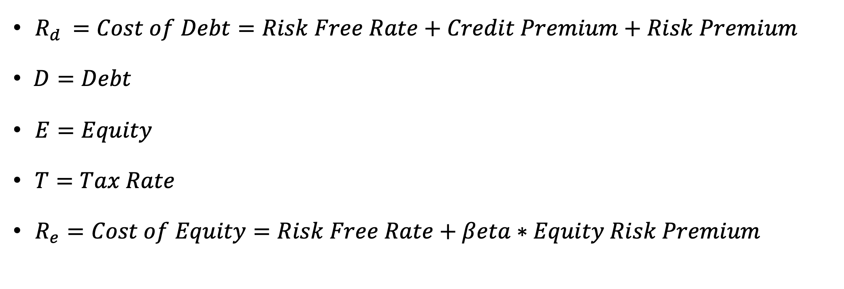
Weighted Average Cost of Capital

Slide 19
What is a Discount Rate? (Cost of Capital)
Weighted Average Cost of Capital (WACC)
Cost of Equity
Cost of Debt
Beta
Equity Risk Premium
Avg Debt Yield
Tax Shield

Slide 20
Defining the Cost of Debt
Cost of Debt can best be thought of as the effective interest rate a company pays on its debt. It is how much lenders demand in return for the risk of the company’s debt
Risk Free Rate: The rate that investors expect no matter the investment. Represents the minimum return an investor demands. Think of the return from buying a U.S. Treasury
Credit Premium: What an investor demands in exchange for crediting a firm. In effect, this can be though of as collateral in exchange for the looming possibility of defaulting – Changes accordingly.
Risk Premium: What an investor demands in collateral for adding risk to their portfolio by investing in debt. Varies based on the risk profile of the asset
Cost of Debt separates in to 2 main sections:
Risk Free Rate: Bottom line Return demanded 🡪 Dependent on Treasury Returns
Credit Spread: Credit Premium and Risk Premium 🡪 Dependent on the companies Risk Profile

Slide 21
How do we find these numbers?
Identify the Credit Rating for the firm and think through a logical credit spread based off both the Credit Rating and Risk profile
Use a table to tell you what the credit spread should be and then add to risk free rate
The Good: Gives you a better idea of interest in regard to what the market demands
The Bad: Does not account for differing types of debt with different yields the firm may be holding. Also credit rating may not be available for a firm
Find the weighted average of yields and interest for the debt the firm holds
Usually, a page in a company 10 K, that will give you a layout of the yields the firm is paying on debt
The Good: Easy to visualize and find, gives the most realistic picture of where the firms debt is sourced from
The Bad: If the firm has entered new markets/positions the risk profile or credit may change towards the future

Slide 22
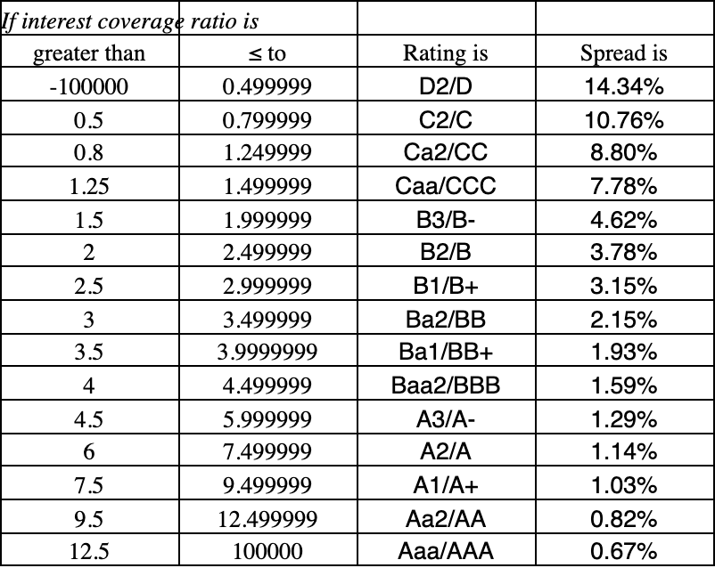
Identifying a Credit Rating and Credit Spread
Say you identify a firm with an A+ credit rating and a 4% Risk Free Rate
Go to the table and find what the credit spread for A+ firms are
Credit Spread for A1/A+ = 1.03%
Recall Cost of Debt Formula
Risk Free Rate + Credit Spread
4% + 1.03% = 5.03% Cost of Debt

Slide 23
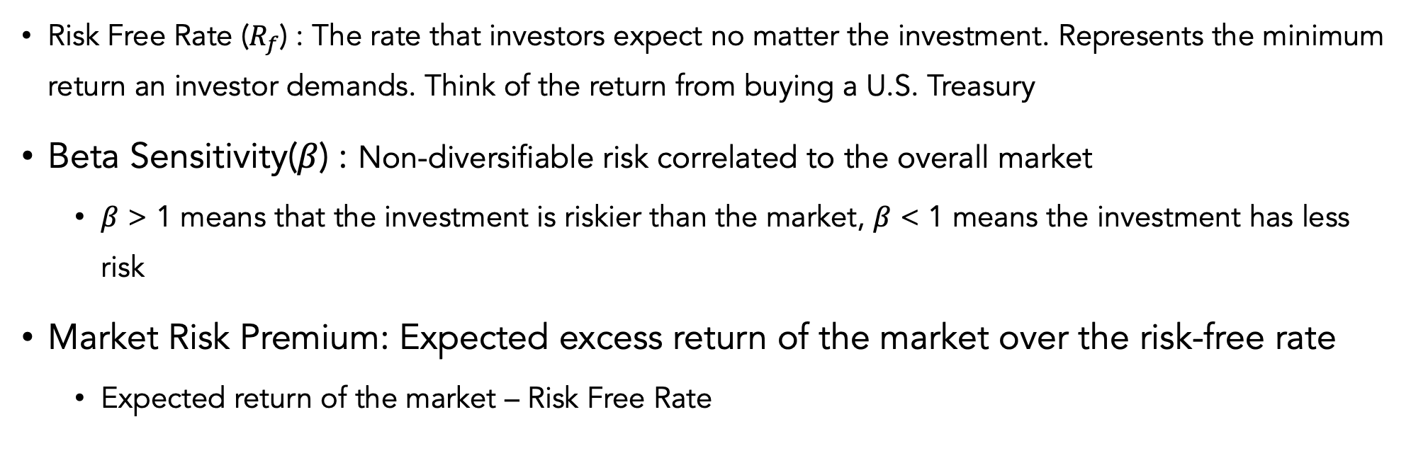
Defining the Cost of Equity (CAPM)
Capital Asset Pricing model gives the expected excess return of any asset given its risk related to the market

Slide 24
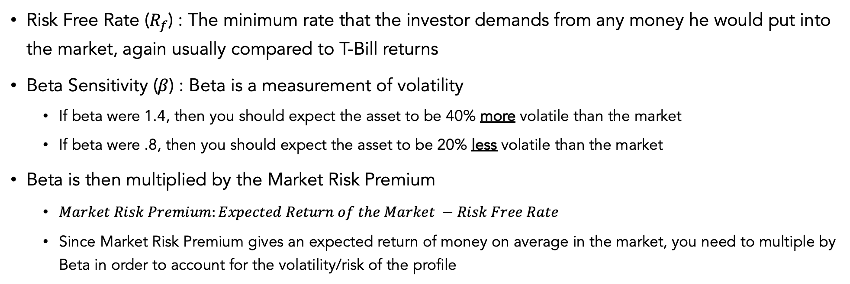
Intuition behind CAPM:

Slide 25
Intuition behind Beta:
What goes into finding calculating Beta and how do we find it?
The Nature of the Business: is the business cyclical?, discretionary products?, types of G/S?
Operating Leverage: fixed costs compared to variable costs (Higher fixed, higher beta and Vice Versa)
Financial Leverage: debt profile of the business, how much does the company have to pay off?
Can usually just take an industry average found from sector and equity reports
High Beta Industries:
Automobiles, Banking, Industrials
Low Beta Industries:
Healthcare, Tech, Consumers (food)
Levered Beta vs. Unlevered
Usually you just use leveraged beta, but you can also use unlevered beta to take out the impact of debt on Beta analysis

Slide 26
Putting it all together:
At the end of the day the formula is a weighted average.
We multiple the computed cost of debt by the proportion of the debt in the business and do the same for cost of equity in order to accurately reflect the impacts of leverage on the business.
Best to think about the return the investor must demand.

Slide 27
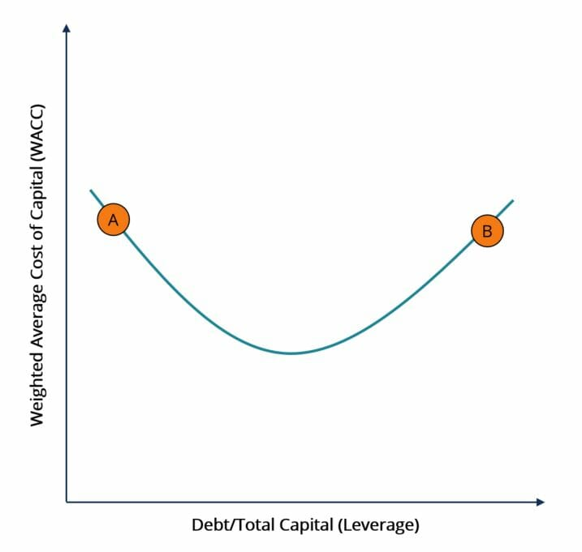
Capital Structure and WACC:
More debt is not always better!

Slide 28
Terminal Value

Slide 29
Finding Terminal Value
We can only accurately project cash flows of a business out for a couple of years with confidence (usually 5-10 years)
The business continues to operate and generate cash flows beyond the projected period
How do we find that number?
1. Gordon Growth Formula
2. Exit Multiple Formula

Slide 30
Gordon Growth Method:
Formulaic and reliant on cash projections
Finding a Terminal Value
Using an Exit Multiple:
Relies on relative valuation to find the final figure

Slide 31
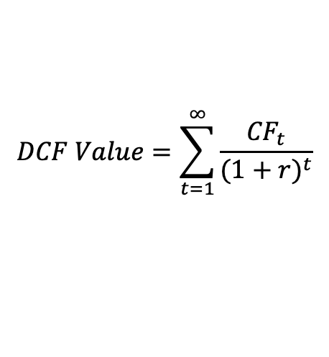
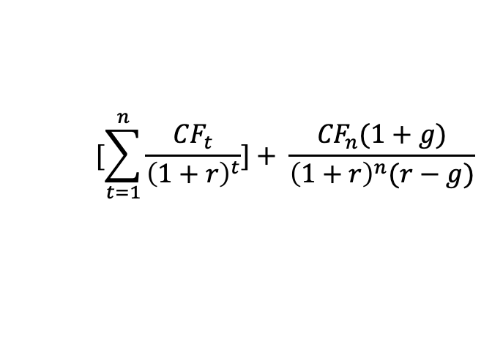

Remembering the Math
Discounted Cash Flow Model
Expands to
Expands to
Calculating Terminal Value
Expands to
CF_{t} = Cash Flow in Year ”t” g = Terminal Growth Rate
r = Discount Rate n = Last year of projections

Slide 32

Using the Gordon Growth Formula
Gives the value of the firm’s cash flow into perpetuity
Remember the EV perpetuity formula
Geometric series function because cash flows converge to 0 in perpetuity (due time value of money)
Cash flows grow at a constant rate (g) into perpetuity
Typically this value is between inflation rate and GDP growth rate
Terminal Value can’t be greater than GDP growth (theoretically) because the firm will eventually be larger than the entire economy
(1+g) because you use the cash flow one year into the constant growth rate

Slide 33
Using the Exit Multiple Strategy
Relies on using relative valuation to find a terminal value
Find a financial metric such as EBITDA, EBIT, etc...
Find a way to multiple to find terminal value
Usually rely on an industry standard
Lastly Discount and Add to find EV
Theoretically not a good way to value because it turns the valuation into relative valuation
Exit Value Multiple
EBITDA
7x EBITDA Exit Multiple

Slide 34
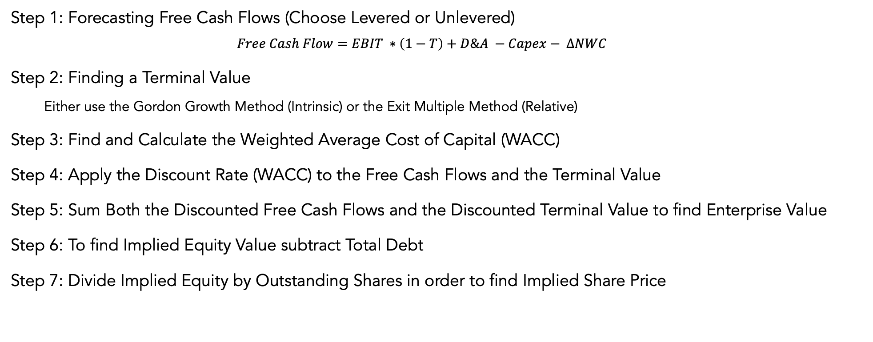
Overview of the Discounted Cash Flow Process

Slide 35
DCF in Practice
When to Use DCF
When Not to Use DCF
Mature Company
Stable Cash Flows
Positive income
Public Companies
You can for private and use comparable companies to estimate Beta/WACC
Variable Cash Flows
Cash Burning Company
Can’t project super far into the future
Free Cash Flow is not a key metric
Financial Institutions

Slide 36
DCF Important Notes
Revenue & Cash Flow growth rates should decline near end of projection
Arrive at sane terminal year growth rate
ROE and ROIC should not be increasing near end of period
Remember Mean Reversion
Typically don’t project beyond 5-10 years as it becomes more unreliable
Make sure Cash Flows are stable

Slide 37
Sample DCF

